Slide 1
Snack Trax
IoT Midterm 1: Smart Room Controller
Phylicia Bediako
July 2025

Slide 2
Introduction
Team
Project Idea & Motivation
Project Lead
Phylicia Bediako
Initial Concept Peer Feedback
Nicole DeVoe Rogers
Cesar Silva
Danny Gallegos
Technical Assistance & Support
IoT Deep Dive instructors
IoT Deep Dive Cohort 16
A food storage tracking system inspired by the IoT Deep Dive snack pantry
Motivated by the fact that the IoT class can request snacks be refilled

Slide 3
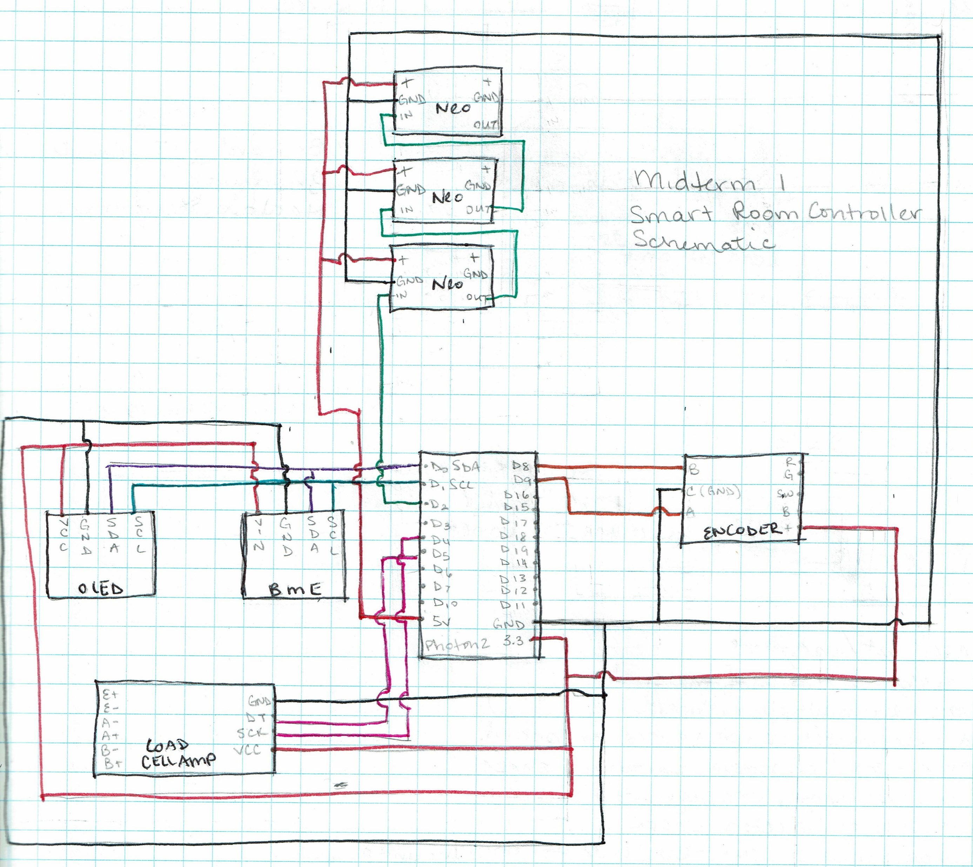
Schematic

Slide 4
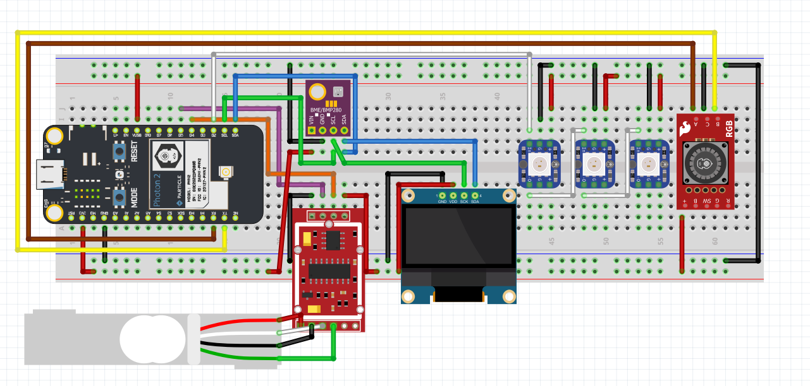
Fritzing

Slide 5
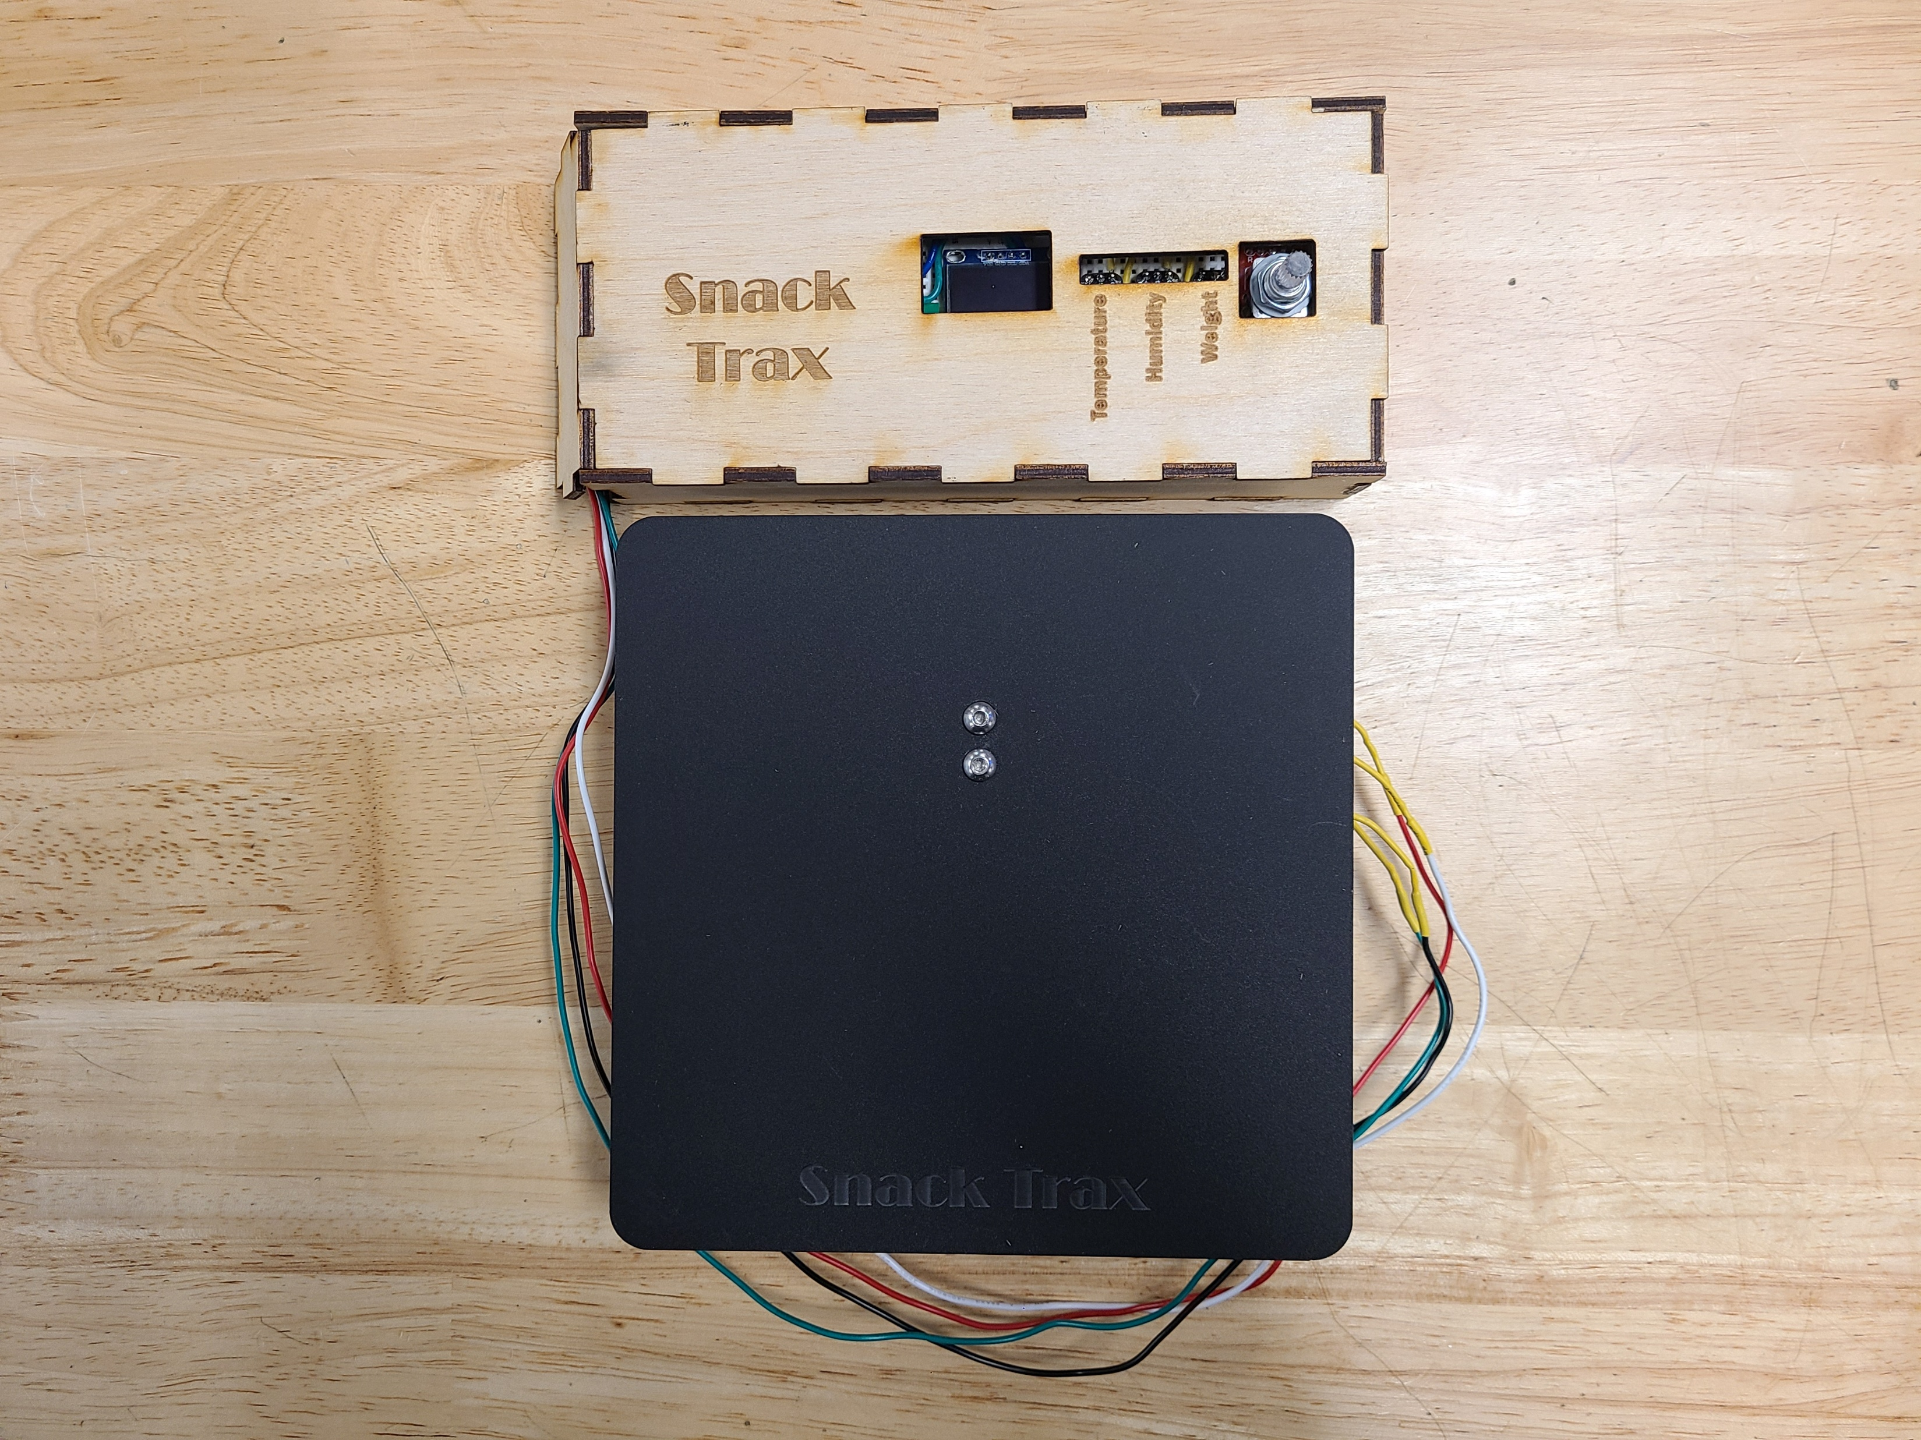
Introduction
Wood-encased control panel
Acrylic scale plate and base
3D printed inner tray

Slide 6
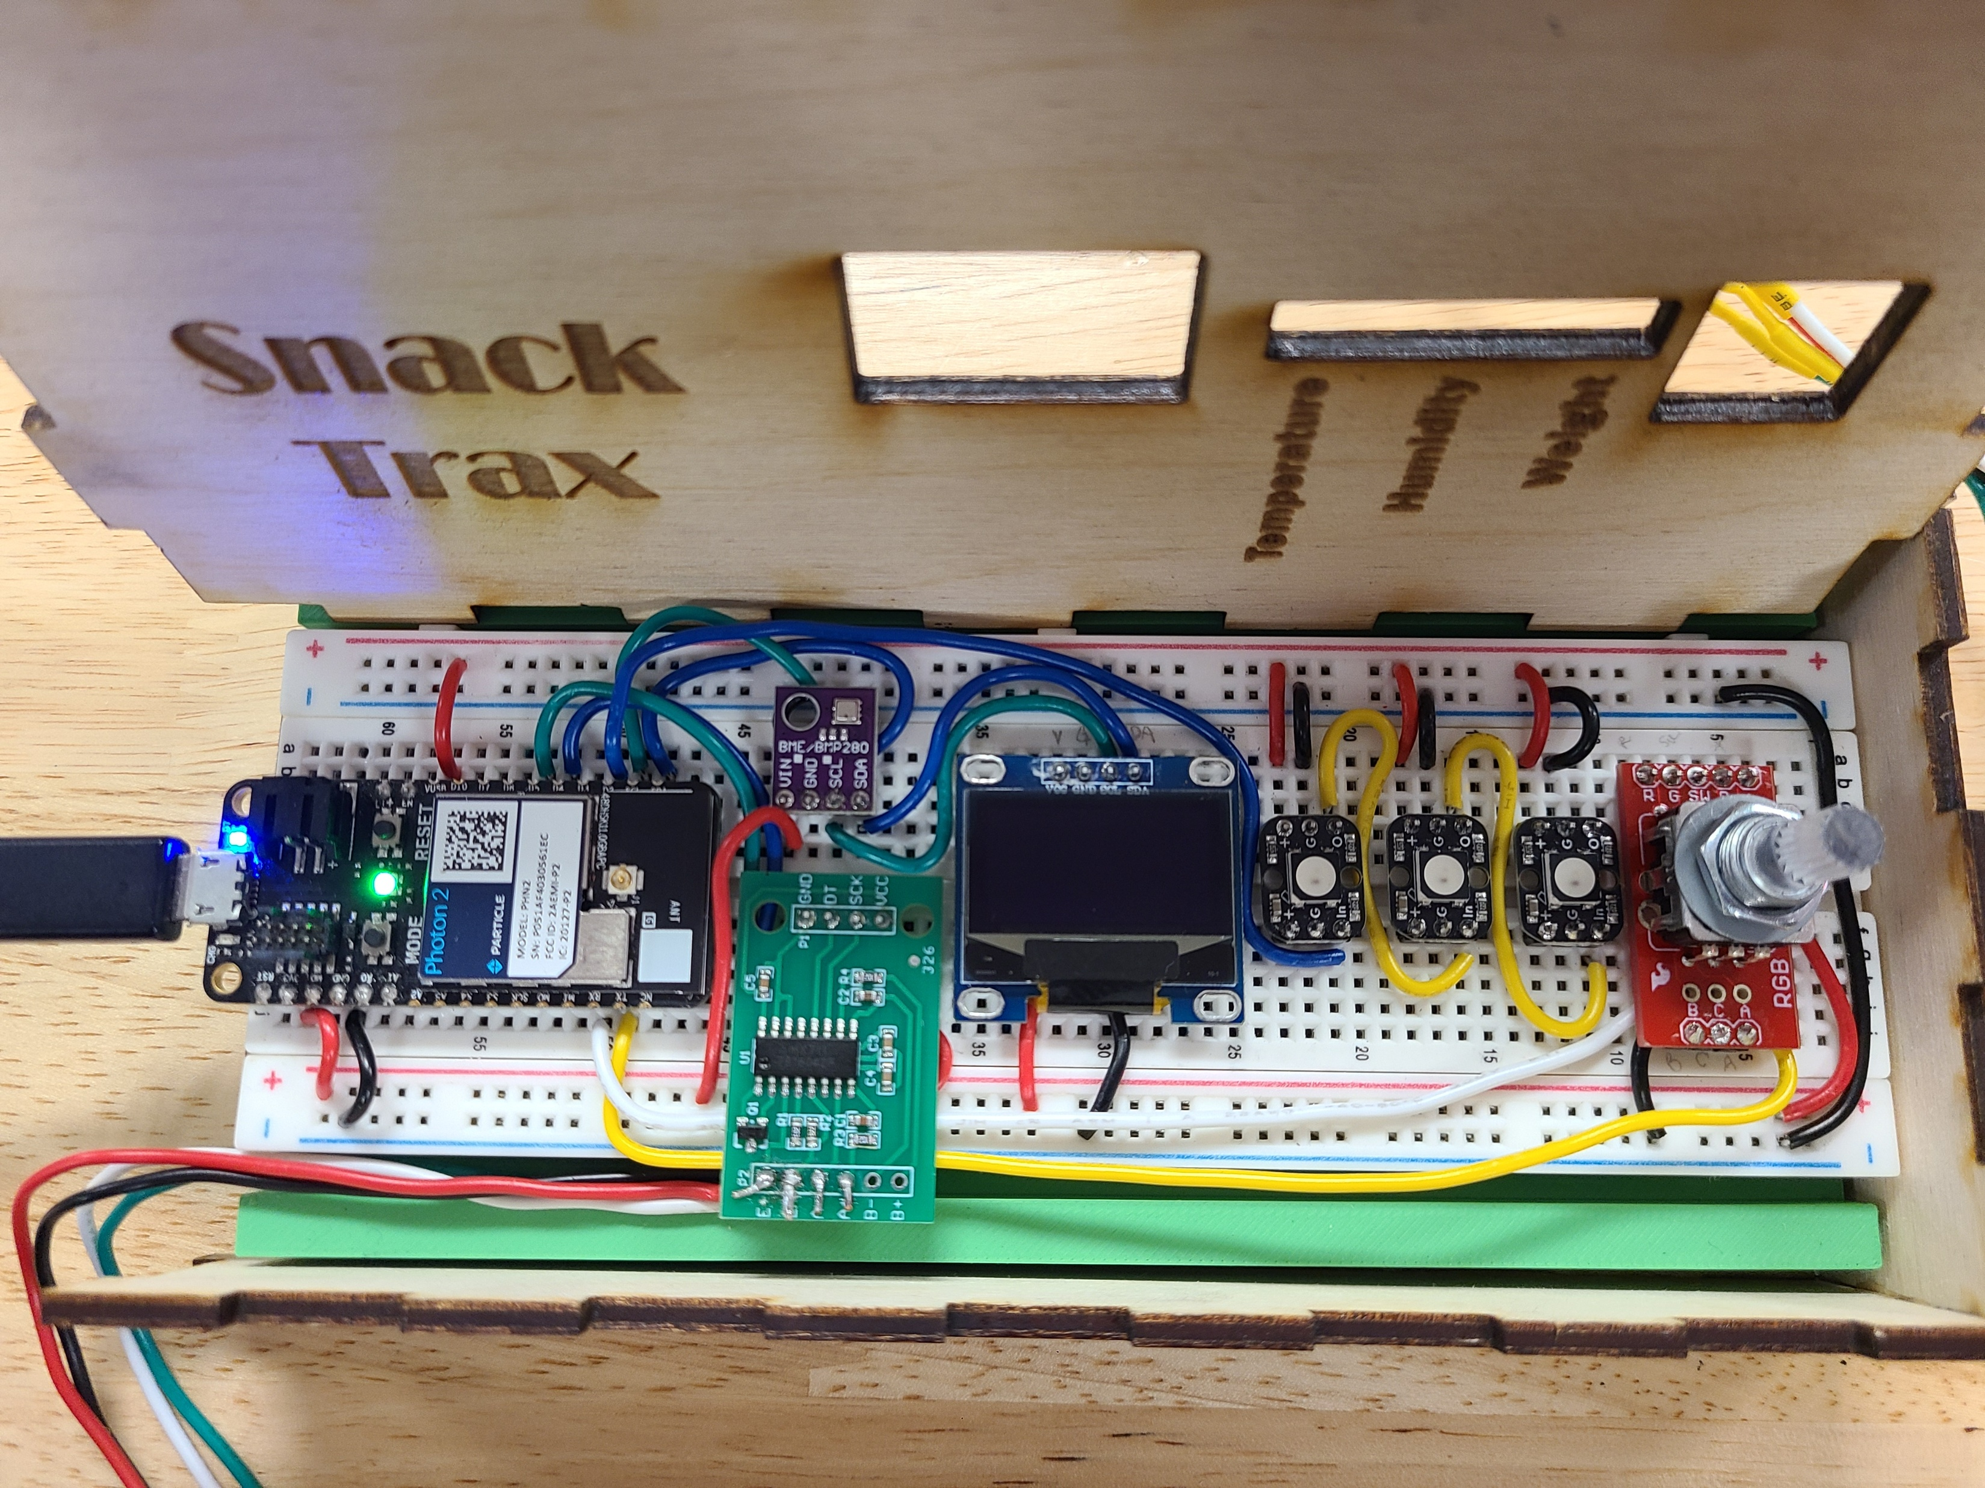
Functionality
Environmental conditions sensor
BME280 provides real-time temperature and humidity readings
tempC=bme.readTemperature();
tempF=(tempC*1.8) +32;
humidRH=bme.readHumidity();
Food scale
HX711 load cell and amp measuring up to 1 kg
snackScale.set_scale();
delay(5000);
snackScale.tare();
snackScale.set_scale(CALFACTOR);
weight = snackScale.get_units(SAMPLES);

Slide 7
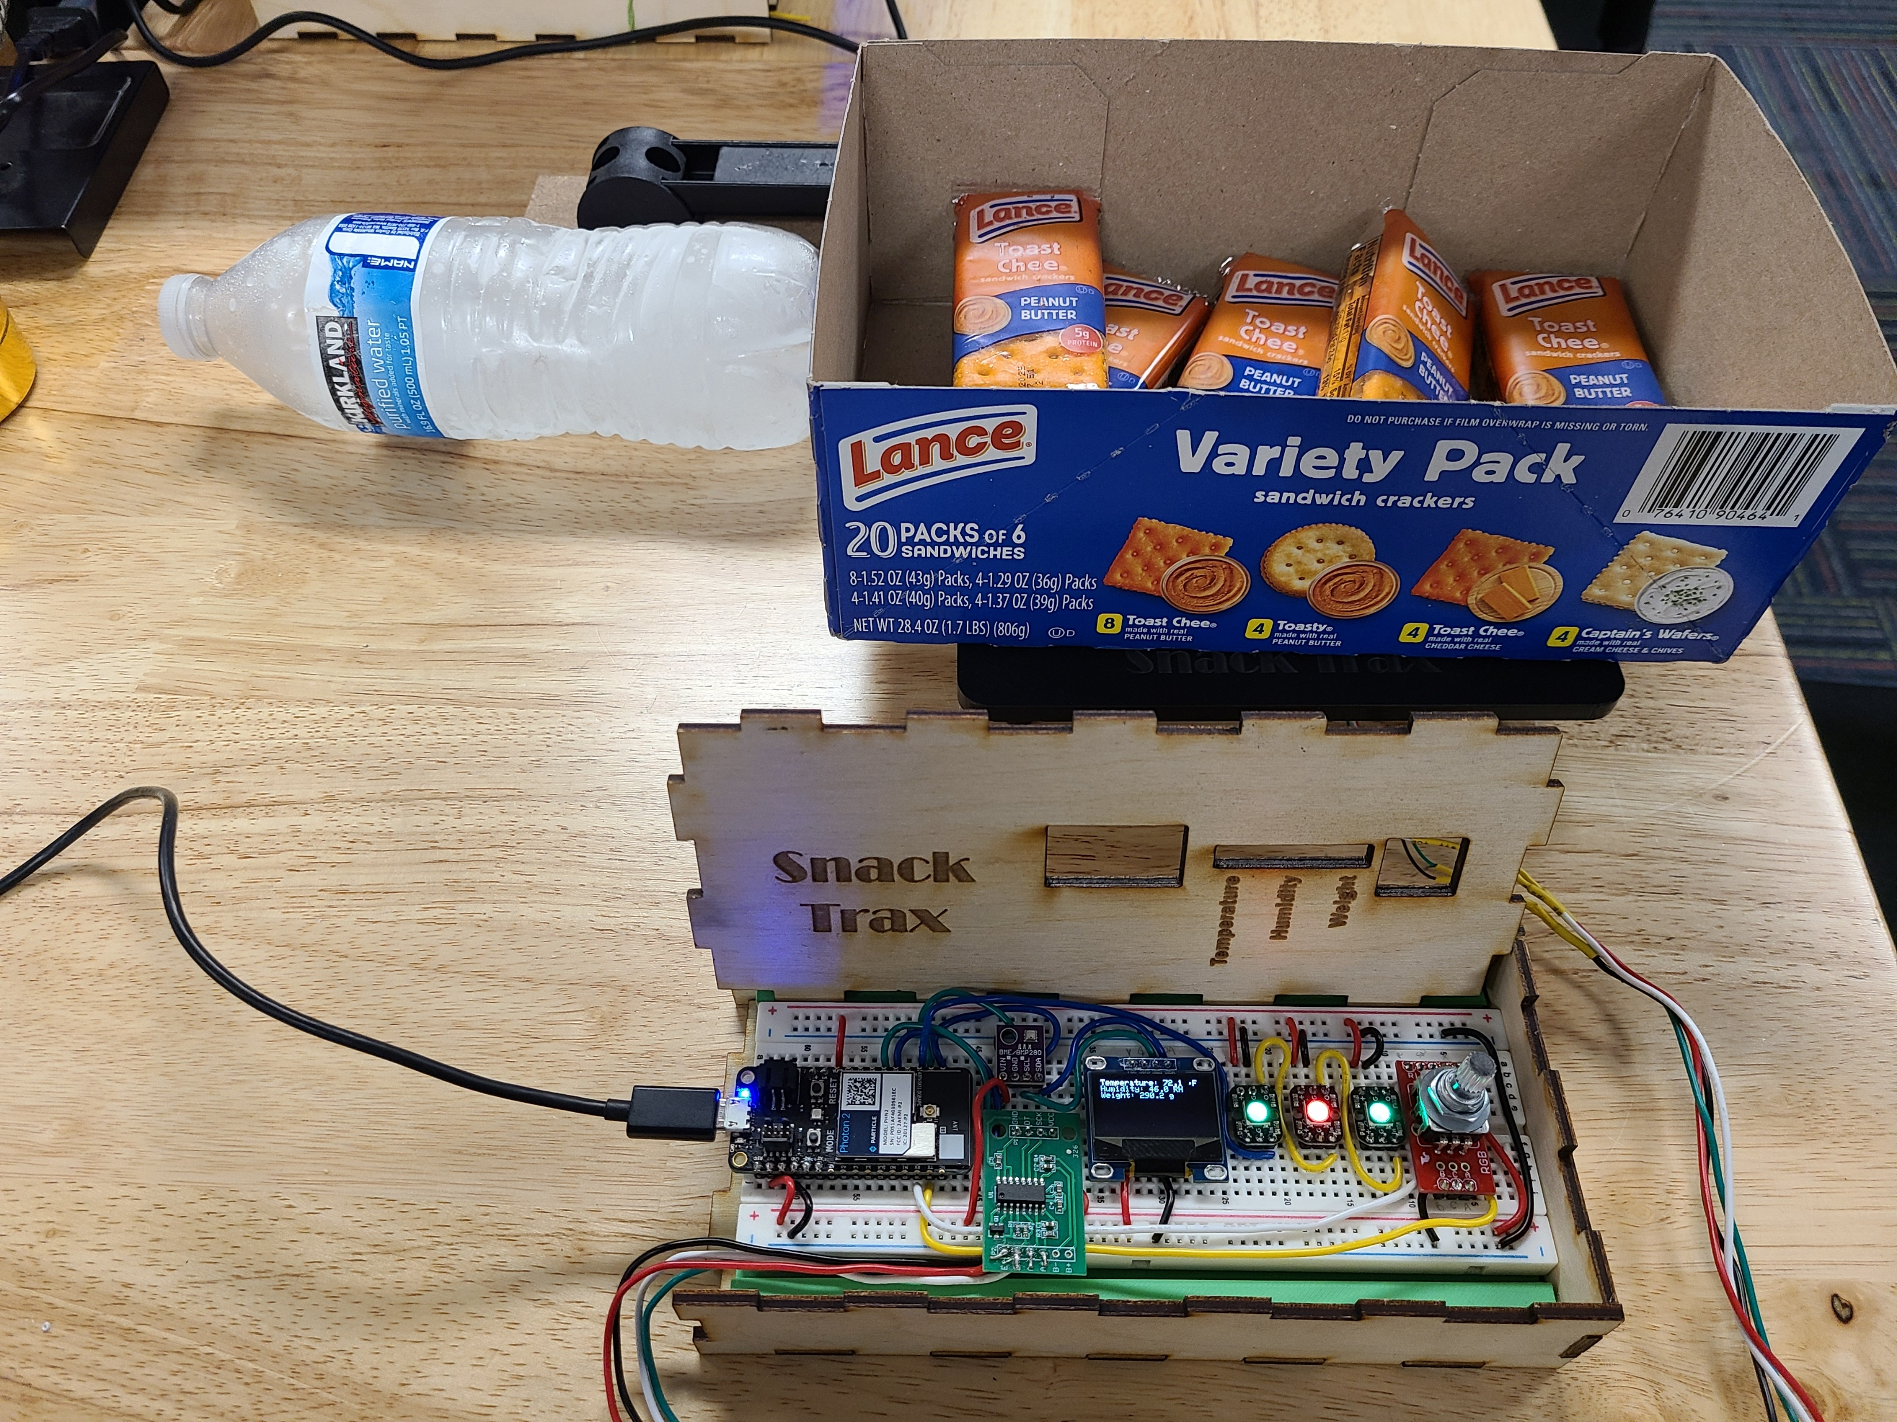
Functionality
Control panel indicator lights
Three neopixels turn red or green based on status
OLED
Shows detailed readings for temperature, humidity, and weight
Smart device capability
Connects to smart hue lights and Wemo for room-wide alerts
Rotary encoder dial adjusts hue light brightness

Slide 8
Notable Challenges
Calibrating the load cell
Reduced size of load cell
Wiring difficulties with separate sensor/scale and display/control elements
Consolidated all functions into one control panel
Determining the right material, sizes, and thickness for the scale plate and base
Some trial and error led to a thicker acrylic scale plate
Table saw did not work to cut acrylic, shifted to miter saw/laser cutter method

Slide 9
Future Steps
Separate control/display and sensor/scale elements
Add capability to adjust ideal temperature, humidity, and weight settings using the control panel
Added “caution” status indicator
Increased weight capacity
Customized, snack-specific settings

